Slide 1
Project Analysis 1. Sales Performance (SQL) 2. MUDAH Condominium Rental KL (Python) Presentation

Slide 2
Project analysis slide 2
Project Analysis Sales Performance (SQL)
Given tables
Table 1: Information from Supply Chain
Normalize Tables
Step 1: Normalize Supply Chain products
Join Tables & Aggregation
Report ‘Sales Performance Summary by Product Capacity’ to manager
Table 2: Information from Sales
Sales Performance Report
Step 4: Join tables on Capacity (64 GB/128 GB/256 GB) & Aggregated to get Sales Performance table
Step 2: Normalize Sales descriptions
Step 3: Fill missing values
Avg.Price
Sales Quantity

Slide 3
Project analysis slide 2
Project Analysis Sales Performance (SQL)
Normalize Tables
Join Tables & Aggregation
Given tables
Sales Performance Project
Table 1:
Information from Supply Chain
Output table:
supply_chain
Table 2:
Information from Sales
Output table:
sales
Output table: sales_filled_capacity
Output table:
final_sales
Output table:
sales_performance

Slide 4
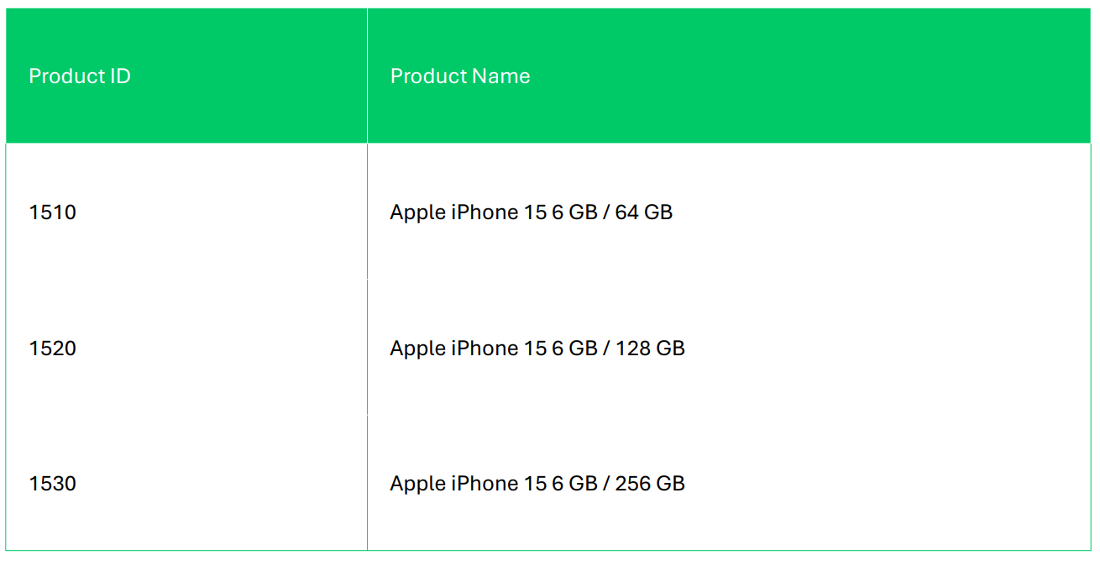
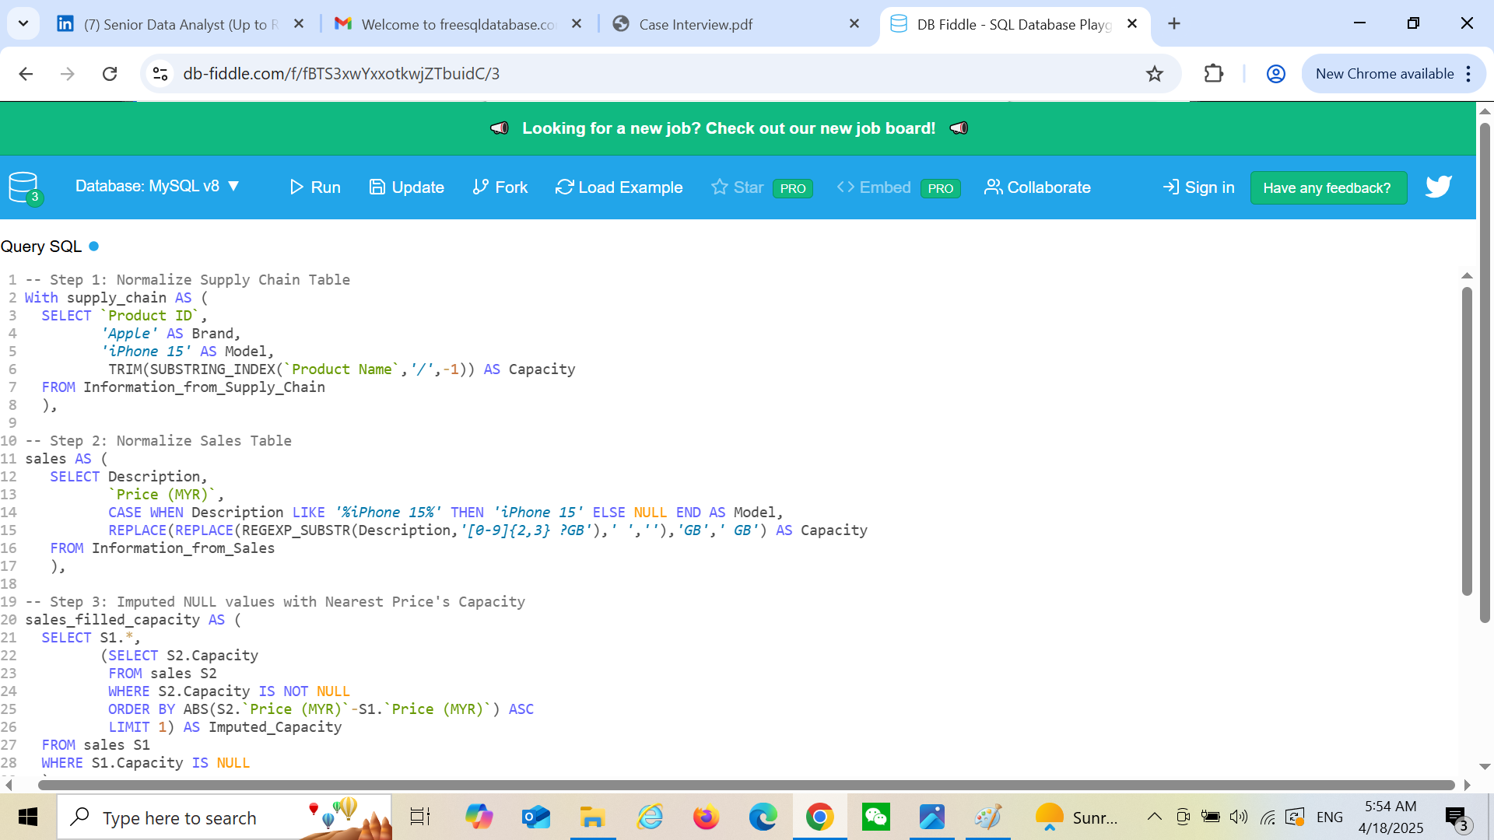
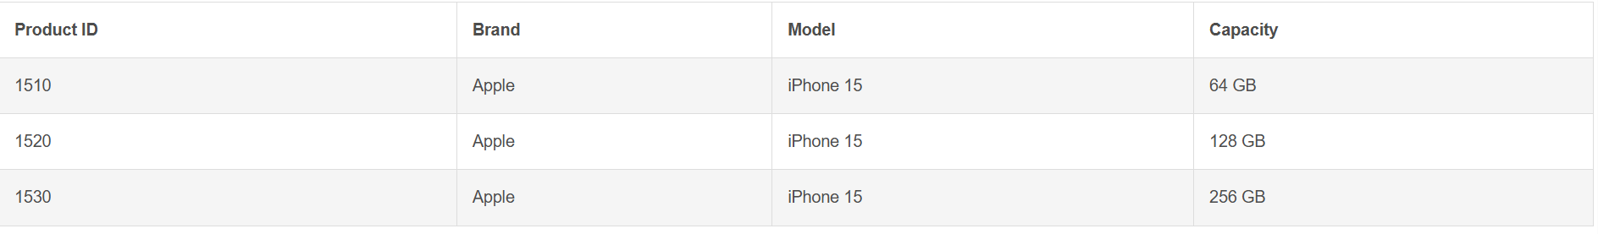
Project analysis slide 2
Project Analysis Sales Performance (SQL)
Step 1:
Normalize Supply Chain products
Extract Brand/Model/Capacity from Table 1
Table 1: Information_from_Supply_Chain
Output Table: supply_chain

Slide 5
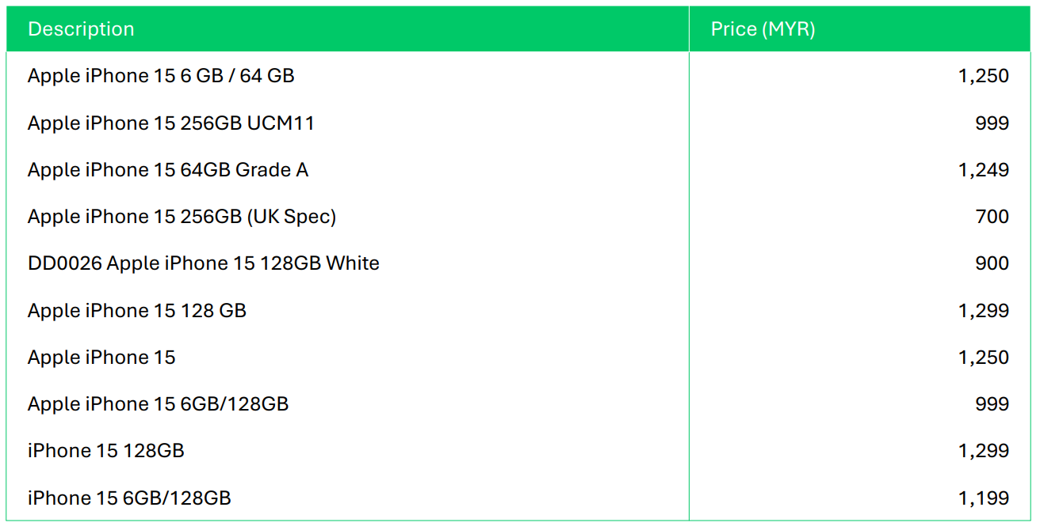
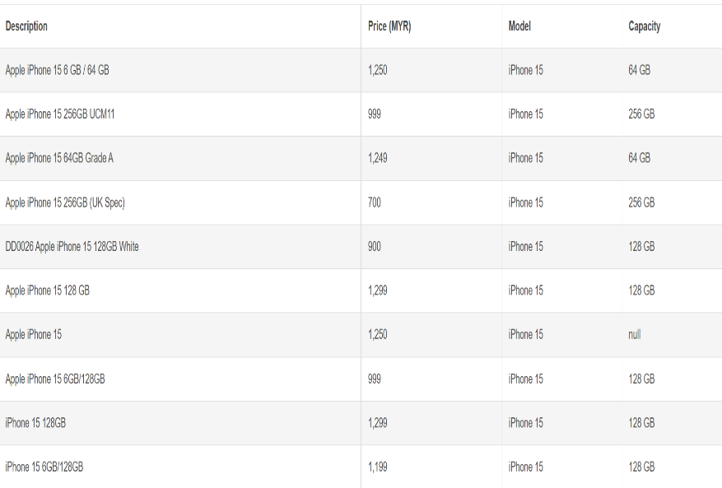
Project analysis slide 2
Project Analysis Sales Performance (SQL)
Step 2:
Normalize Sales descriptions
Extract Price/Model/Capacity from Table 2
Table 2: Information_from_Sales
Missing Capacity
Missing Value
Output Table: sales

Slide 6
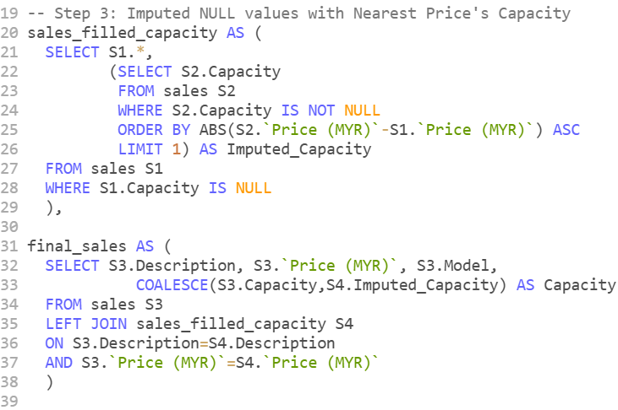
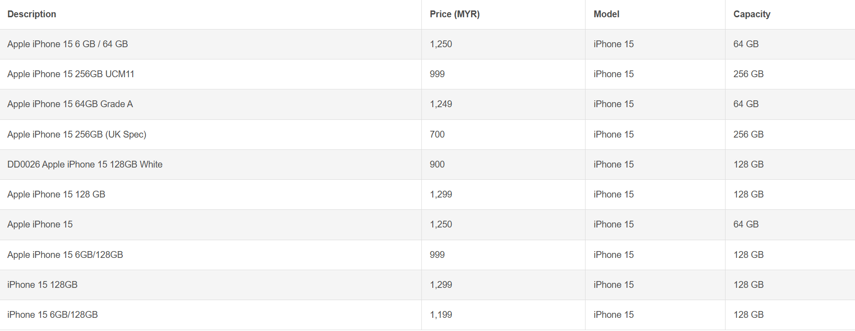
Project analysis slide 2
Project Analysis Sales Performance (SQL)
Step 3:
Fill missing values
Imputed With Nearest price’s Capacity from Table 2
Table 2: Information_from_Sales
Nearest Price
Output Table: final_sales

Slide 7
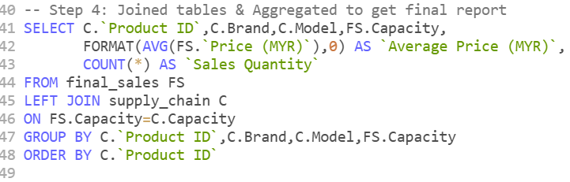
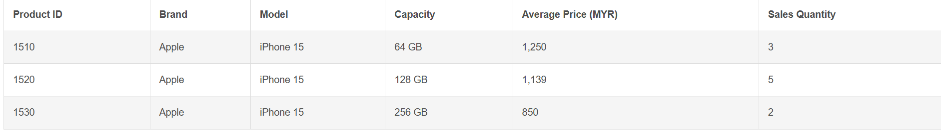
Project analysis slide 2
Project Analysis Sales Performance (SQL)
Step 4:
Join tables on Capacity
Aggregated Avg Price & Sales Qty
Output Table: sales_performance

Slide 8
Project analysis slide 5
Project Analysis Sales Performance (SQL)
64 GB
128 GB
256 GB
MYR 1,250
MYR 1,139
MYR 850
Sales Quantity : 3
Sales Quantity : 5
Sales Quantity : 2

Slide 9
Project analysis slide 2
Project Analysis MUDAH Web Scrape (Python)
WEB SCRAPING FOR APARTMENTS AND CONDOMINIUMS IN KUALA LUMPUR FROM MUDAH
Scrapes all listing pages
Install packages (requests + beautifulsoup)
Extracts Property Name, Area, Size, Rental
Normalization
Cleans text with regex
Handles missing/null fields
Exports
Exports to CSV
Create dashboards
Grouping Area and Property Name
Aggregation
Aggregate average rental and size

Slide 10
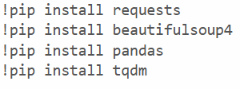
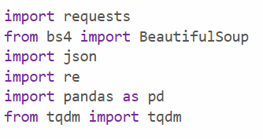
Project analysis slide 2
Project Analysis MUDAH Web Scrape (Python)
Scrapes all listing pages
Install packages (requests + beautifulsoup)
Extracts Property Name, Area, Size, Rental
Packages Install

Slide 11
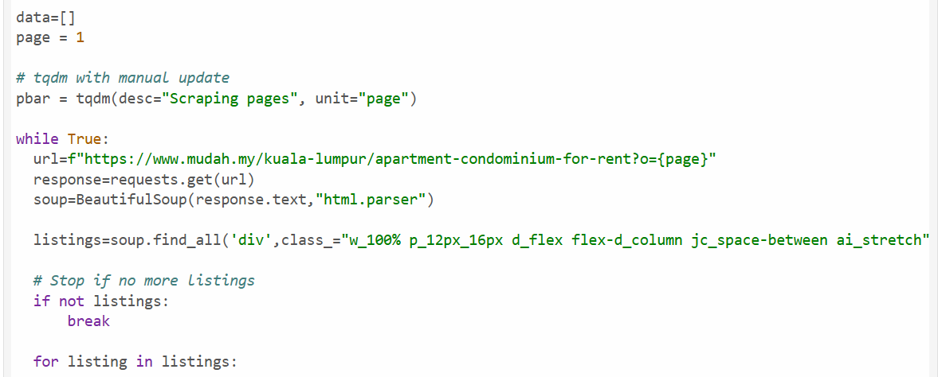
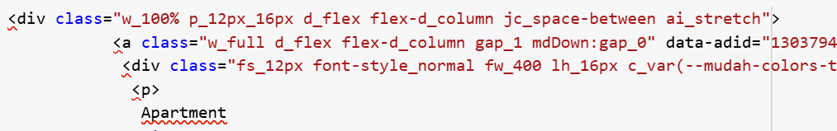
Project analysis slide 2
Project Analysis MUDAH Web Scrape (Python)
Scrapes all listing pages
Install packages (requests + beautifulsoup)
Extracts Property Name, Area, Size, Rental
Scrapes all listing pages
Website url
soup.prettify()

Slide 12
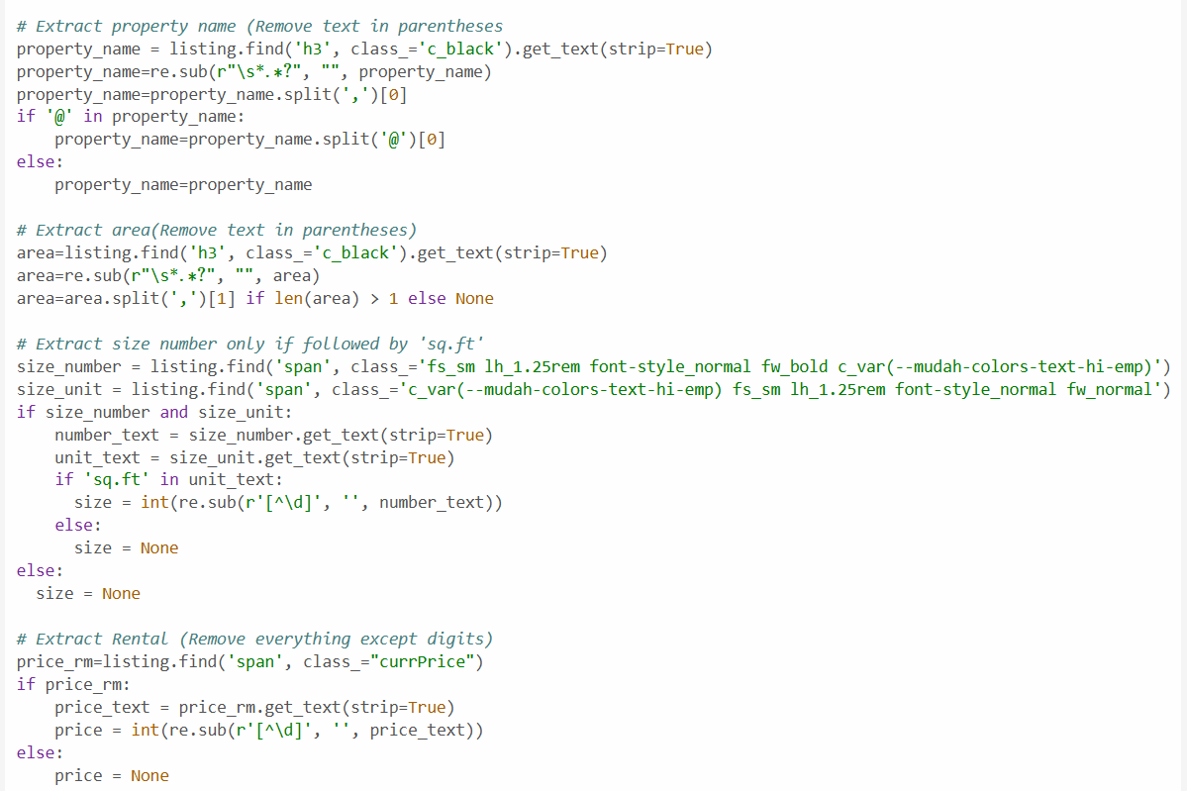
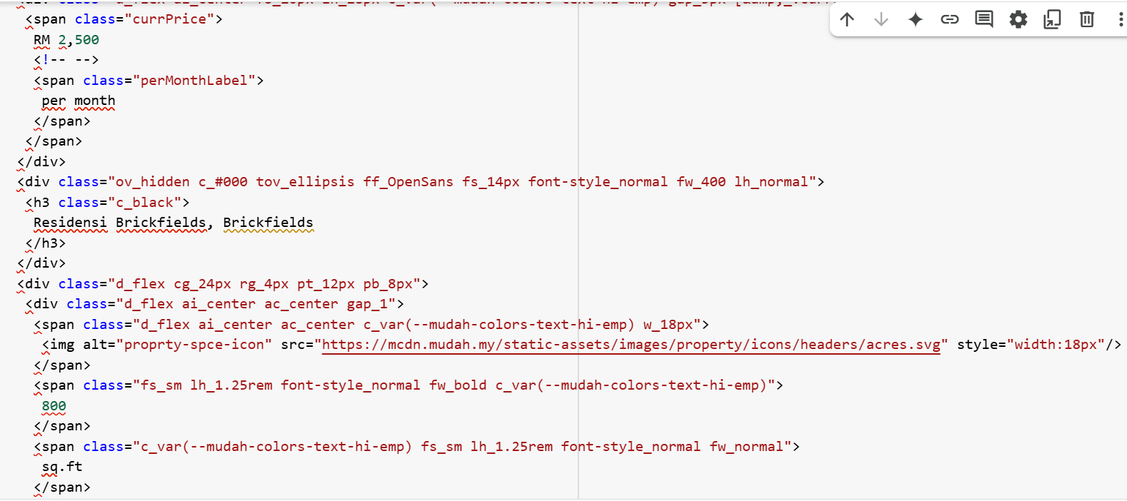
Project analysis slide 2
Project Analysis MUDAH Web Scrape (Python)
Scrapes all listing pages
Install packages (requests + beautifulsoup)
Extracts Property Name, Area, Size, Rental
soup.prettify()
Extract Property Name & Area
Extract Size (sqft)
soup.prettify()
Extract Rental

Slide 13
Project analysis slide 2
Project Analysis MUDAH Web Scrape (Python)
Normalization
Cleans text with regex
Handles missing/null fields
Normalization for
Property name - str
Area - str
Size (sqft) - int
Rental (MYR) - int

Slide 14
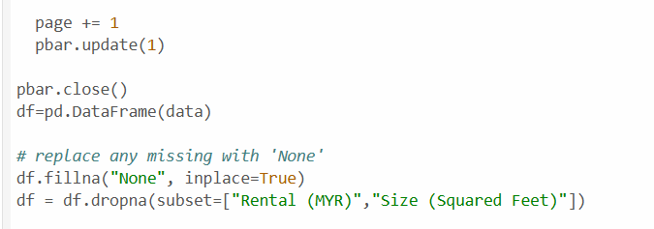
Project analysis slide 2
Project Analysis MUDAH Web Scrape (Python)
Normalization
Cleans text with regex
Handles missing/null fields
Handle Missing Value
Replace any missing vale with ‘None’
Drop all rows contain ‘None’ especially in Rental & Size columns

Slide 15
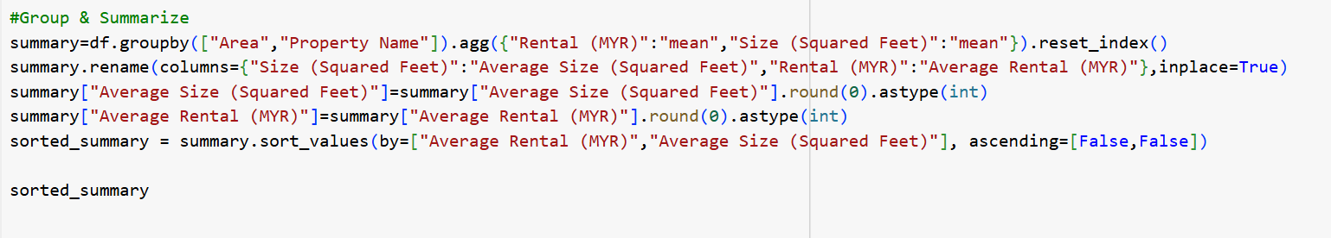
Project analysis slide 2
Project Analysis MUDAH Web Scrape (Python)
Aggregation
Grouping Area and Property Name
Aggregate average rental and size
Groupby
Aggregation
Find Average Price & Average Size

Slide 16
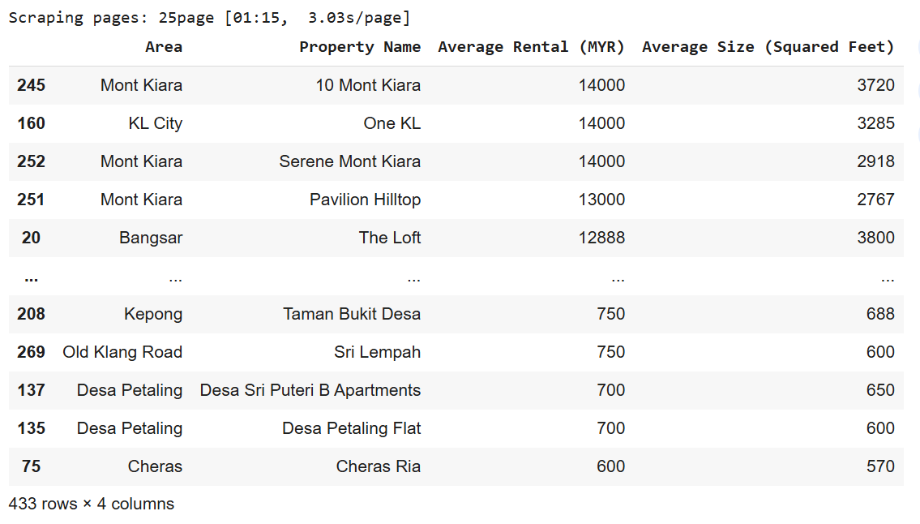
Project analysis slide 2
Project Analysis MUDAH Web Scrape (Python)
Aggregation
Grouping Area and Property Name
Aggregate average rental and size
sorted_summary

Slide 17
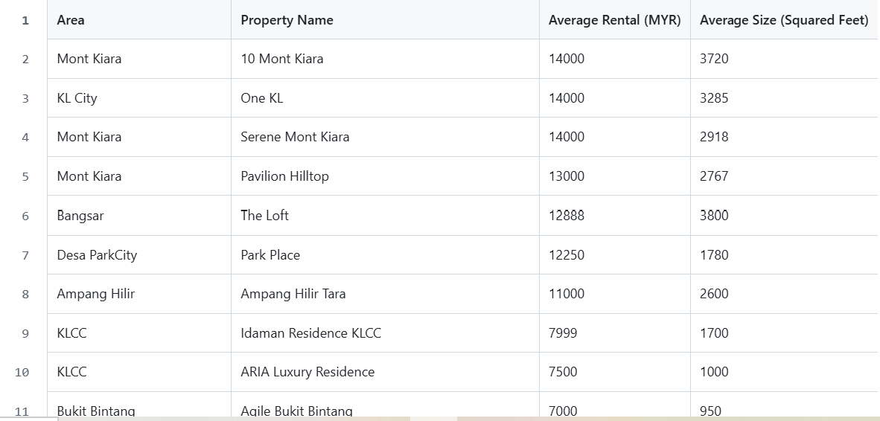
Project analysis slide 2
Project Analysis MUDAH Web Scrape (Python)
Exports
Exports to CSV
Create dashboards
csv.file

Slide 18
Project analysis slide 5
Project Analysis MUDAH Web Scrape (Python)
TOP 1
TOP 2
TOP 3
10 Mont Kiara
One KL
Serene Mont Kiara
Area: Mont Kiara
Average Size(Sq.ft): 3,720
Average Rental (MYR) : 14,000
Area: KL City
Average Size(Sq.ft): 3,285
Average Rental (MYR) : 14,000
Area: Mont Kiara
Average Size(Sq.ft): 2,918
Average Rental (MYR) : 14,000

Slide 19
Project analysis slide 2
Project Analysis MUDAH Web Scrape (Python)
Python Code:
!pip install requests
!pip install beautifulsoup4
!pip install pandas
!pip install tqdm
import requests
from bs4 import BeautifulSoup
import json
import re
import pandas as pd
from tqdm import tqdm
data=[]
page = 1
# tqdm with manual update
pbar = tqdm(desc="Scraping pages", unit="page")
while True:
url=f"https://www.mudah.my/kuala-lumpur/apartment-condominium-for-rent?o={page}"
response=requests.get(url)
soup=BeautifulSoup(response.text,"html.parser")
#soup.prettify()
listings=soup.find_all('div',class_="w_100% p_12px_16px d_flex flex-d_column jc_space-between ai_stretch")
# Stop if no more listings
if not listings:
break
for listing in listings:
# Extract property name (Remove text in parentheses
property_name = listing.find('h3', class_='c_black').get_text(strip=True)
property_name=re.sub(r"\s*\(.*?\)", "", property_name)
property_name=property_name.split(',')[0]
if '@' in property_name:
property_name=property_name.split('@')[0]
else:
property_name=property_name
# Extract area(Remove text in parentheses)
area=listing.find('h3', class_='c_black').get_text(strip=True)
area=re.sub(r"\s*\(.*?\)", "", area)
area=area.split(',')[1] if len(area) > 1 else None
# Extract size number only if followed by 'sq.ft'
size_number = listing.find('span', class_='fs_sm lh_1.25rem font-style_normal fw_bold c_var(--mudah-colors-text-hi-emp)')
size_unit = listing.find('span', class_='c_var(--mudah-colors-text-hi-emp) fs_sm lh_1.25rem font-style_normal fw_normal')
if size_number and size_unit:
number_text = size_number.get_text(strip=True)
unit_text = size_unit.get_text(strip=True)
if 'sq.ft' in unit_text:
size = int(re.sub(r'[^\d]', '', number_text))
else:
size = None
else:
size = None
# Extract Rental (Remove everything except digits)
price_rm=listing.find('span', class_="currPrice")
if price_rm:
price_text = price_rm.get_text(strip=True)
price = int(re.sub(r'[^\d]', '', price_text))
else:
price = None
data.append({'Area': area,
'Property Name':property_name,
'Rental (MYR)':price,
'Size (Squared Feet)': size
})
page += 1
pbar.update(1)
pbar.close()
df=pd.DataFrame(data)
# replace any missing with 'None'
df.fillna("None", inplace=True)
df = df.dropna(subset=["Rental (MYR)","Size (Squared Feet)"])
#Group & Summarize
summary=df.groupby(["Area","Property Name"]).agg({"Rental (MYR)":"mean","Size (Squared Feet)":"mean"}).reset_index()
summary.rename(columns={"Size (Squared Feet)":"Average Size (Squared Feet)","Rental (MYR)":"Average Rental (MYR)"},inplace=True)
summary["Average Size (Squared Feet)"]=summary["Average Size (Squared Feet)"].round(0).astype(int)
summary["Average Rental (MYR)"]=summary["Average Rental (MYR)"].round(0).astype(int)
sorted_summary = summary.sort_values(by=["Average Rental (MYR)","Average Size (Squared Feet)"], ascending=[False,False])
sorted_summary
sorted_summary.to_csv('mudah_rental_data.csv', index=False)

Slide 20
Project analysis slide 2
Project Analysis Sales Performance (SQL)
SQL Code:
-- Step 1: Normalize Supply Chain Table
With supply_chain AS (
SELECT `Product ID`,
'Apple' AS Brand,
'iPhone 15' AS Model,
TRIM(SUBSTRING_INDEX(`Product Name`,'/',-1)) AS Capacity
FROM Information_from_Supply_Chain
),
-- Step 2: Normalize Sales Table
sales AS (
SELECT Description,
`Price (MYR)`,
CASE WHEN Description LIKE '%iPhone 15%' THEN 'iPhone 15' ELSE NULL END AS Model,
REPLACE(REPLACE(REGEXP_SUBSTR(Description,'[0-9]{2,3} ?GB'),' ',''),'GB',' GB') AS Capacity
FROM Information_from_Sales
),
-- Step 3: Imputed NULL values with Nearest Price's Capacity
sales_filled_capacity AS (
SELECT S1.*,
(SELECT S2.Capacity
FROM sales S2
WHERE S2.Capacity IS NOT NULL
ORDER BY ABS(S2.`Price (MYR)`-S1.`Price (MYR)`) ASC
LIMIT 1) AS Imputed_Capacity
FROM sales S1
WHERE S1.Capacity IS NULL
),
final_sales AS (
SELECT S3.Description, S3.`Price (MYR)`, S3.Model,
COALESCE(S3.Capacity,S4.Imputed_Capacity) AS Capacity
FROM sales S3
LEFT JOIN sales_filled_capacity S4
ON S3.Description=S4.Description
AND S3.`Price (MYR)`=S4.`Price (MYR)`
)
-- Step 4: Joined tables & Aggregated to get final report
SELECT C.`Product ID`,C.Brand,C.Model,FS.Capacity,
FORMAT(AVG(FS.`Price (MYR)`),0) AS `Average Price (MYR)`,
COUNT(*) AS `Sales Quantity`
FROM final_sales FS
LEFT JOIN supply_chain C
ON FS.Capacity=C.Capacity
GROUP BY C.`Product ID`,C.Brand,C.Model,FS.Capacity
ORDER BY C.`Product ID`

Slide 21
Thank You

